Slide 1
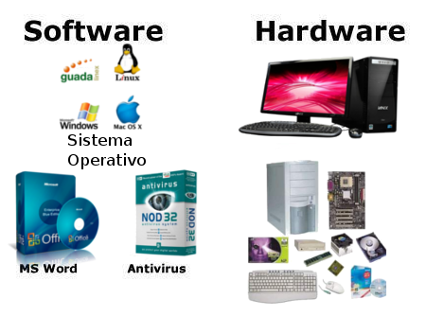
SEN / CSE111 ICT
Hardware and Software
Lecture 5 (Week 3)
By Mr. Faheem Shaukat
faheem@iqraisb.edu.pk
www.tinyurl.com/IUICLectures

Slide 2
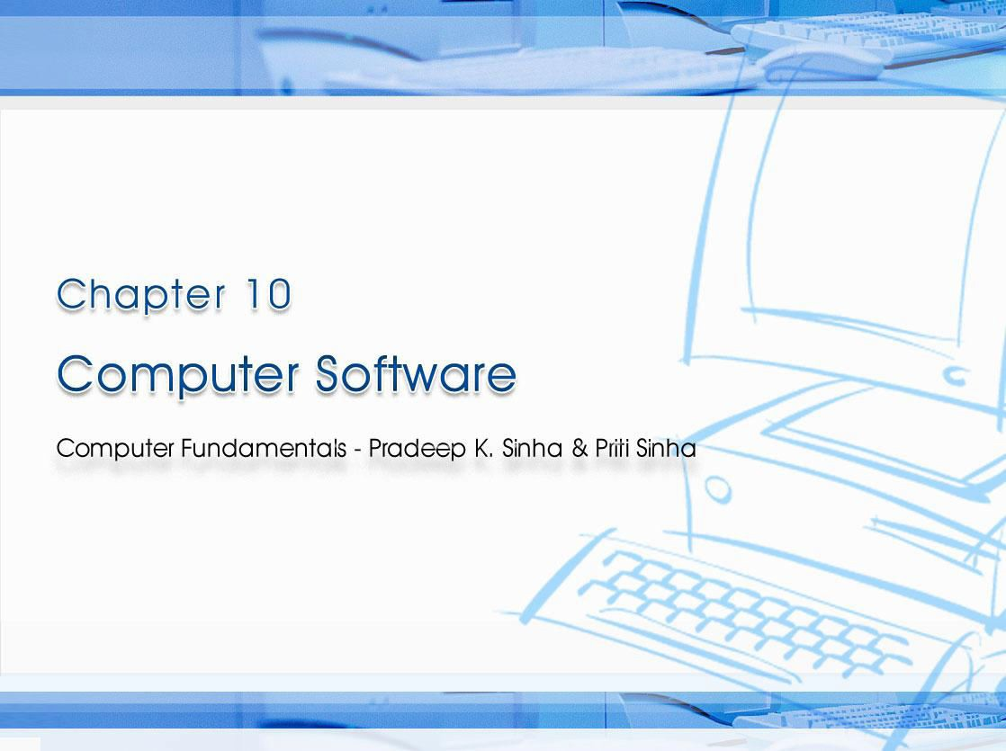
CCoommppuutterer FFununddaammenenttaallss:: PPrradadeeeepp KK.. SSiinhnhaa && PPrriititi SSiinhanha
Ref Page Chapter 10: Computer Software Slide 1/17

Slide 3

Computer Fundamentals: Pradeep K. Sinha & Priti Sinha
Learning Obj ect ives
I n this chapter you w ill learn about:
§ Term “Software” and its relationship with “Hardware”
§ Various types of software and their examples
§ Relationship among hardware, system software, application software, and users of a computer system
§ Various steps involved in software development
§ Firmware
§ Middleware
172

Slide 4
Soft w are
Computer Fundamentals: Pradeep K. Sinha & Priti Sinha
§ Hardw are refers to the physical devices of a computer system.
§ Softw are refers to a collection of programs
§ Program is a sequence of instructions written in a language that can be understood by a computer
§ Softw are package is a group of programs that solve a specific problem or perform a specific type of job
172

Slide 5
Computer Fundamentals: Pradeep K. Sinha & Priti Sinha
Relat ionship Bet w een Hardw are and Soft w are
§ Both hardware and software are necessary for a computer to do useful job. They are complementary to each other
§ Same hardware can be loaded with different software to make a computer system perform different types of jobs
§ Except for upgrades, hardware is normally a one- time expense, whereas software is a continuing expense
§ Upgrades refer to renewing or changing components like increasing the main memory, or hard disk capacities, or adding speakers, modems, etc.
173

Slide 6
Computer Fundamentals: Pradeep K. Sinha & Priti Sinha
Types of Soft w are
Most software can be divided into two major categories:
§ System softw are are designed to control the operation and extend the processing capability of a computer system
§ Application softw are are designed to solve a specific problem or to do a specific task
173

Slide 7
Computer Fundamentals: Pradeep K. Sinha & Priti Sinha
Syst em Soft w are
§ Make the operation of a computer system more effective and efficient
§ Help hardware components work together and provide support for the development and execution of application software
§ Programs included in a system software package are called system program s and programmers who prepare them are called system program m ers
§ Examples of system software are operating systems, programming language translators, utility programs, and communications software
173

Slide 8
Computer Fundamentals: Pradeep K. Sinha & Priti Sinha
Applicat ion Soft w are
§ Solve a specific problem or do a specific task
§ Programs included in an application software package are called application program s and the programmers who prepare them are called
application program m ers
§ Examples of application software are word processing, inventory management, preparation of tax returns, banking, etc.
174

Slide 9
Computer Fundamentals: Pradeep K. Sinha & Priti Sinha
W ays of Acquir ing Soft w are
§ Buying pre-written software
§ Ordering
customized software
§ Developing customized software
§ Downloading public-domain software
Each of these ways of acquiring software has its own advantages and limitations
176

Slide 10
Computer Fundamentals: Pradeep K. Sinha & Priti Sinha
Soft w are Developm ent St eps
Developing a software and putting it to use is a complex process and involves following steps:
§ Analyzing the problem at hand and planning the program(s) to solve the problem
§ Coding the program(s)
§ Testing, debugging, and documenting the program(s)
§ Implementing the program(s)
§ Evaluating and maintaining the program(s)
178

Slide 11
Firm w are
Computer Fundamentals: Pradeep K. Sinha & Priti Sinha
§ Firmware is software substituted for hardware and stored in read-only memory
§ Firmware technology has enabled production of various types of smart machines having microprocessor chips with embedded software
179

Slide 12
Middlew are
Computer Fundamentals: Pradeep K. Sinha & Priti Sinha
§ Basic idea is to have a separate software layer to:
§ Act as “glue” between client and server parts of application
§ Provide programming abstraction
§ Mask heterogeneity of underlying network, hardware, and OS
§ Encourages three- t ier software architecture against two- tier popularized by Server-Client architecture
179

